Slide 1

Introduction to algorithms graphs
Lecture 9
Thursday, 25 November 2021

Slide 2
Definition of a graph
A graph is a mathematical concept.
G=(V,E)
A graph is a collection of Vertices and Edges
A
B
Edge
Vertex (vertices)
C
D

Slide 3
definition
A graph is a mathematical concept.
G=(V,E)
A graph is a collection of Vertices and Edges
Degree:
The number of edges coinciding (joining) each vertex
D
A
A
B
C
D
deg(A)=
3
A
0 | 1 | 1 | 1
1 | 0 | 1 | 0
1 | 1 | 0 | 1
1 | 0 | 1 | 0
3
deg(B)=
2
B
2
C
3
B
D
2
C
3
2
3
2

Slide 4
Path/cycle
A path on a graph is represented by a set of edges that join a set of (distinct) vertices
D
A
Path: B-A-D
B
C

Slide 5
Path/cycle
A path on a graph is represented by a set of edges that join a set of (distinct) vertices
D
A
Path: B-A-C
B
C

Slide 6
Path/cycle
A path on a graph is represented by a set of edges that join a set of (distinct) vertices
D
A
Not a Path!
B
Problem at vertex A
C
B-A-C-A-D
A is visited twice!!

Slide 7
Path/cycle
A path on a graph is represented by a set of edges that join a set of (distinct) vertices
D
A
Cyclic Path:
C-A-D-C
B
cycle
C
A cycle is a path where it ends at the same starting vertex

Slide 8
Path/cycle
How many cycles are there in the following graph?
D
A
3 cycles
B
C

Slide 9
Tree graphs
A tree is a graph with no cycles
Can find a unique path between any two vertices
F
F
F
B
E
B
E
B
E
C
C
C
D
D
D
A
A
A
tree
disjoint graph

Slide 10
Complete graph
A complete graph is a graph in which each pair of vertices are connected by a unique edge
NO
YES
YES
NO
YES

Slide 11
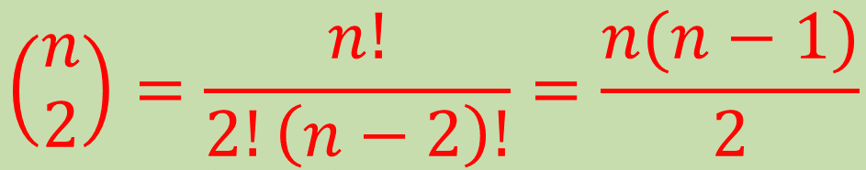
complete graph – number of edges
How many edges are there in a complete graph with n vertices??
3
6
n=3
n=4
$$\left(\begin{matrix}n \\ 2\end{matrix}\right)=\frac{n!}{2!\left(n−2\right)!}=\frac{n(n−1)}{2}$$
Choosing pairs from n vertices

Slide 12
complete graph - degree
What is the
degree of each
vertex in a
complete graph?
deg(A)=n-1
A
n-1 vertices

Slide 13
Bipartite graph
Bipartite graph is a graph whose vertices can be divided into two disjoint and independent sets

Slide 14
Bipartite graphs – examples
D
A
A
B
B
C
D
C
bipartite
There’s NO connection from A to C nor is from B to D !!

Slide 15
Bipartite graphs – examples
D
A
A
B
B
C
D
C
NOT bipartite !!
A graph with a triangular cycle in it can’t be bipartite !

Slide 16
Directed graph
B-A-C
D
A
direction doesn’t matter
C-A-B
B
C
D
A
directed graph (digraph)
direction does matter
B
C

Slide 17
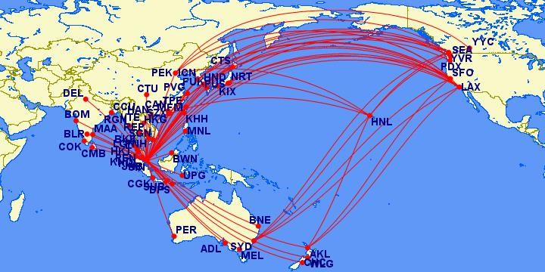
Applications of graphs
Graphs are used in modelling networks

Slide 18
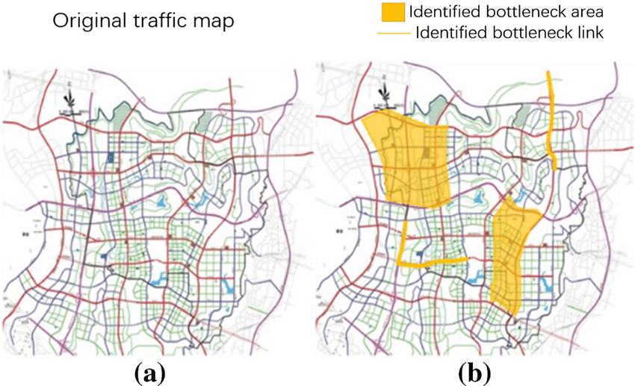
Applications of graphs
Graphs are used in modelling networks

Slide 19
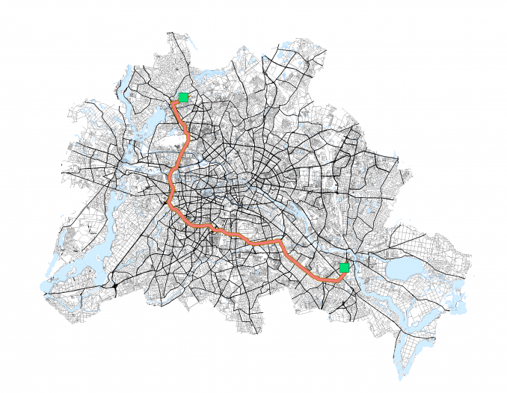
Applications of graphs
Graphs are used in modelling networks

Slide 20
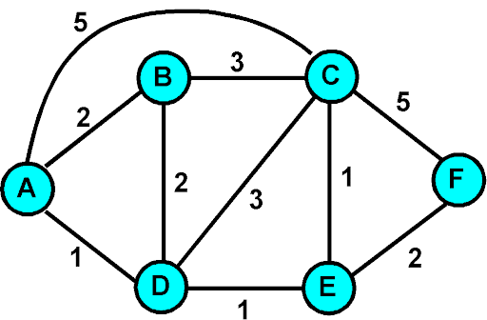
Weighted graphs
weights
weighted graphs have numerical values assigned to each edge.

Slide 21
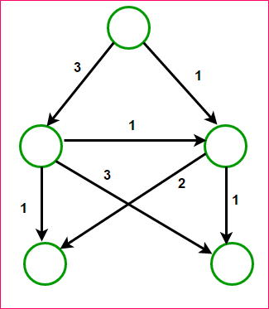


Shortest path algorithms – dijkstra (weighted digraphs)
A
Find the shortest paths from vertex A to all other vertices
source
0
No direct edge from vertex A to vertex D
3
1
B
C
Choose the vertex with smallest weight
$$∞$$
$$∞$$
3
E
D
2

Slide 22
Shortest path algorithms – dijkstra (weighted digraphs)
source
A
0
Choose the next vertex with smallest weight
4
Vertex D has no outgoing edge
3
1
B
C
Choose the next vertex with smallest weight
6
3
2
E
D
4

Slide 23
Shortest path algorithms – dijkstra (weighted digraphs)
source
A
0
Choose the next vertex with smallest weight
Vertex E has no outgoing edge
STOP!
3
1
B
C
best path
min cost
A => C
1
A => B
3
Google maps route finding
3
2
E
D
A => D
2
A => E
3

